Slide 1
Flexible Search
Module-06

Slide 2
Contents
Overview
Syntax
API examples

Slide 3
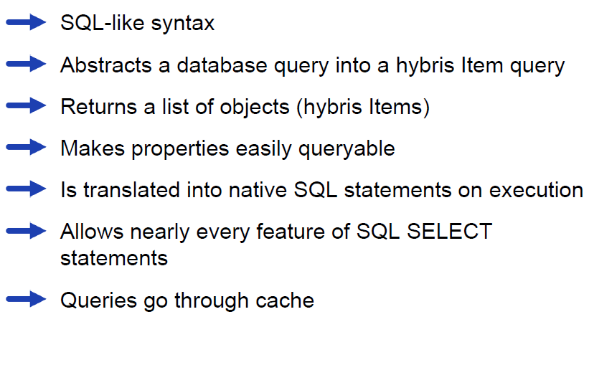
Overview

Slide 4
Contents
Overview
Syntax
API examples

Slide 5
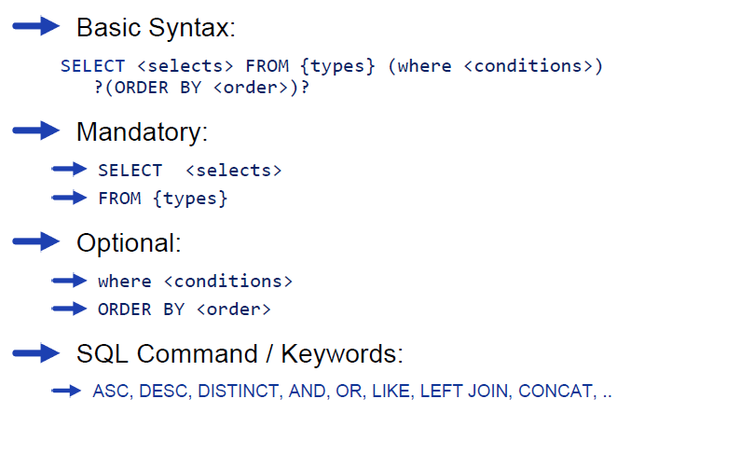
Syntax

Slide 6
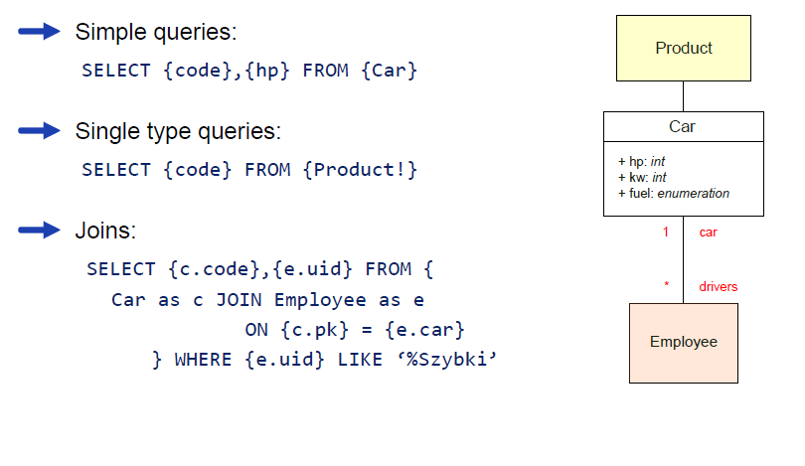
Query examples

Slide 7
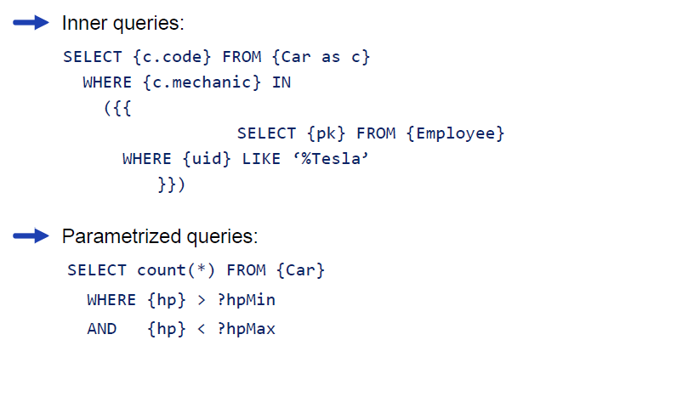
More query examples

Slide 8
Contents
Overview
Syntax
API examples

Slide 9
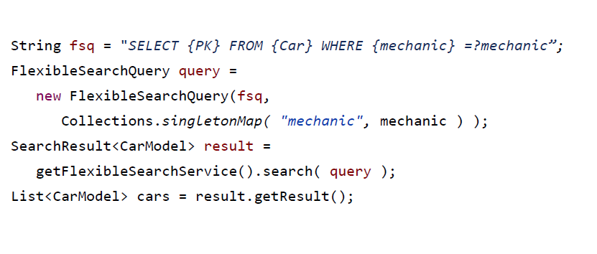
Querying with parameters

Slide 10
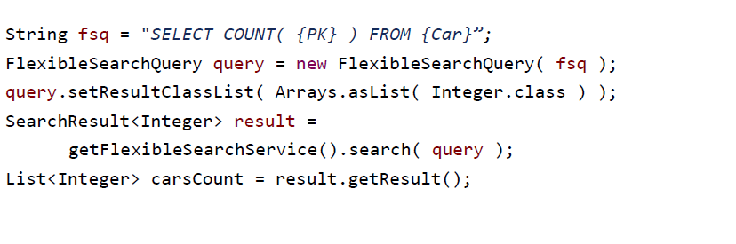
Querying for other types than Models

Slide 11
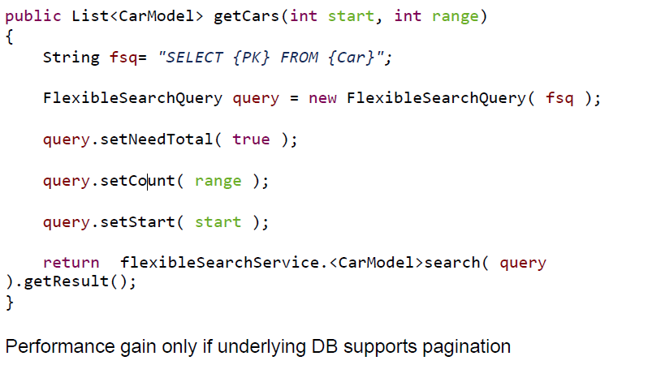
Pagination

Slide 12
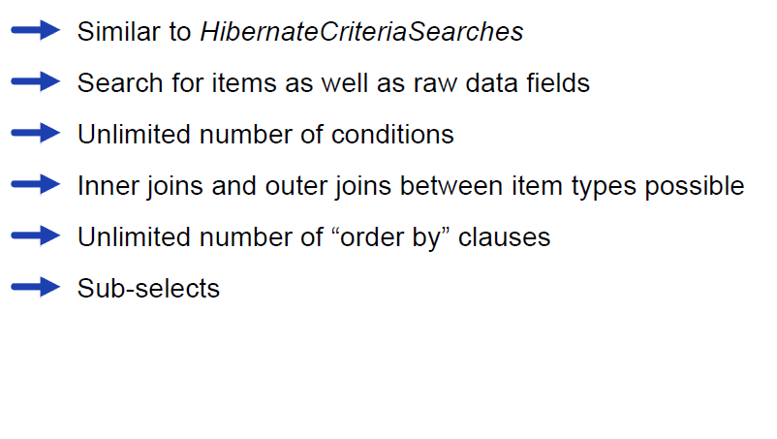
Generic Search

Slide 13
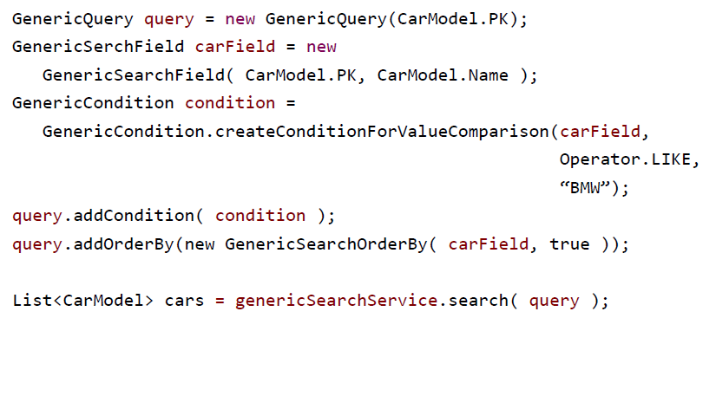
Generic Search Example

